Slide 1
Ontology Design Approaches
Group 12
BUI TIEN TUNG - 20231058M
HUU TUONG TU - 20232282M

Slide 2
Introduction
Ontology Design Criteria
Ontology Design Methodologies
Conclusion

Slide 3
Introduction
What is in an ontology?
Ontology, investigates “the categories of things that exist or may exist” in a particular domain and produces a catalog that details the types of things and the relations between those types that are relevant for that domain. (John Sowa)
Ontology as “an explicit specification of a conceptualization.” (Tom Gruber)
An ontology is a representation of shared knowledge for a community

Slide 4
Introduction
Why develop an ontology?
To share common understanding of the structure of information among people or software agents
To enable reuse of domain knowledge
To make domain assumptions explicit
To separate domain knowledge from the operational knowledge
To analyze domain knowledge

Slide 5
Introduction
How develop an ontology?
Where to start?
How many people are needed for the ontology design?
How we ascertain that we are on the right track?
Whether similar ontologies already exist?
How to determine that we are designing a valid ontology?

Slide 6
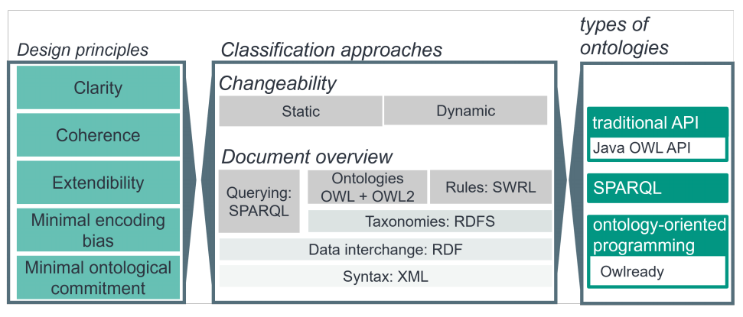
II. Ontology Design Criteria
Notes:
Tiêu chuẩn cho thiết kế ontology
Gồm 5 tiêu chuẩn chính:

Slide 7
II. Ontology Design Criteria
5 design criteria for ontologies (Gruber 1995):
Clarity
Coherence
Extensibility
Minimal encoding bias
Minimal Ontological Commitment
Notes:
1. Clarity (Xác định): xác định lý do chọn các khái niệm ontology, định nghĩa rõ ràng về ontology nâng cao hiệu quả giao tiếp giữa các thành phần.
Ví dụ: khi định nghĩa về gen ta định nghĩa "gen nằm trên DNA" là không rõ ràng vì có những phần khác nằm trên DNA không phải là gen, việc định nghĩa thiếu thông tin sẽ làm thông tin sẽ bị hiểu theo ý nghĩa khác nhau.
2. Coherence (Mạch lạc): CÁc mệnh đề suy ra từ các định nghĩa ontology không được mâu thuẫn với định nghĩa ontology khác, các suy luận, định nghĩa dc thêm vào mới phải nhất quán với các suy luận và định nghĩa hiện tại. Ví dụ như pizza chay được định nghĩa là không có thịt nhưng pizza cà chua thuộc pizza chay lại định nghĩa cho thêm thịt => mâu thuẫn.
3. Extendeibility (Khả năng mở rộng): Ontology cần phải có khả năng mở rộng dễ dàng, định nghĩa mới ontology phải xác định dựa trên những định nghĩa cho sẵn và không thay đổi nó, việc mở rộng mục đích tạo ra định nghĩa chính xác hơn.
4. Minimal encoding bias (encode tối thiểu): Việc định nghĩa 1 ontology cần tập trung vào ý nghĩa và khái niệm của nó, thay vì tập trung vào cách biểu diễn thông tin dễ dàng. Ví dụ: Việc tạo 1 định nghĩa các ontology phải dựa trên thông tin cốt lõi, thay vì dựa trên việc biểu diễn trên một tool format dễ dàng.
5. Minimal Ontological Commitment: Việc xây dựng các ontology nên xây dựng với số lượng thực thể và mối quan hệ ít nhất để đạt được mục đích mong muốn. Ví dụ như mô tả đồ nội thất nên tập trung vào thực thể cơ bản như ghế, bàn, vật liệu, màu sắc thay vì những thứ như "tựa lưng" "không tựa" trừ khi nhiệm vụ cụ thể của mình liên quan đến phân biệt loại bàn ghế, tuy nhiên đôi khi việc thêm các thông tin cụ thể làm cho biểu diễn trở nên rõ ràng hơn, MOC cần xây dựng dựa trên nhiệm vụ cụ thể.

Slide 8
II. Ontology Design Criteria
1. Clarity
Need to be clear about the reasons for choosing
a particular set of ontology terms
the intended meanings of terms.
Clear definitions of ontology terms will contribute to the effectiveness of communication between agents.

Slide 9
Example: Design University Ontology
Clarity example:
“Undergraduate-Student”: any individual who is enrolled in a full-time program leading to a bachelor's degree at a recognized university. This enrollment must be their primary activity. The program must be accredited by the relevant educational authority.
Lack of clarity example
“Undergraduate-Student”: is someone who studies at a university or a similar institution.
Not specify the level of study
Not require enrollment in an accredited program
Not define what constitutes "studies" or a "similar institution"

Slide 10
II. Ontology Design Criteria
2. Coherence
Propositions that can be inferred from the ontology definitions and axioms may not contradict other ontology definitions and axioms.
Inferences need to be consistent with the existing definitions and axioms, and should be clear and logical.

Slide 11
Example: Design University Ontology
Coherence example:
Axiom 1: All faculty members are university employees.
Axiom 2: All university employees are eligible for university health benefits.
Inferred Proposition: All faculty members are eligible for university health benefits.
Lack of coherence example
Axiom 1: All full-time students are eligible for on-campus housing.
Axiom 2: Graduate students are not eligible for on-campus housing.
Inferred Proposition: Full-time graduate students are not eligible for on-campus housing.
Full-time graduate students is both full-time student and graduate student. This creates a contradiction between axiom 1 and axiom 2.

Slide 12
II. Ontology Design Criteria
3. Extensibility
The ontology needs to be easily extendable.
The new ontology terms should be easily defined based on the
existing vocabulary and/or preferably without the need to alter the existing ontology definitions.

Slide 13
Example: Design University Ontology
Extensibility example:
Original Term: “Academic-Staff”: any individual employed by the university who contributes to teaching and research activities.
New knowledge: New role Postdoctoral Researcher, defined as an individual who conducts post-PhD research but may also engage in teaching activities.
→ New Term: “Postdoctoral-Researcher” is a type of “Academic-Staff” engaged primarily in post-PhD research, with potential involvement in teaching activities.
Lack of Extensibility example
Original Term: “Student”: an individual enrolled in courses at the university.
New knowledge: Introduction of online learning programs and the need to distinguish between on-campus and online students.
→ New Term: “Online-Student” as an individual not present on campus but enrolled in courses. → Need change definition of “Student”

Slide 14
II. Ontology Design Criteria
4. Minimal encoding bias
Conceptualizations need to be specified at a knowledge-level and not at a symbol-level.
Should not compromise the correctness of an ontology for the convenience of its notation or implementation.

Slide 15
Example: Design University Ontology
Minimal encoding bias example:
“Role” is an abstract concept with subclasses for “Student”, “Faculty”, and “Staff”. Each subclass can have relationships
→ This structure allows for the representation of roles and their relationships without presupposing a specific way of encoding or managing these roles
Lack of Minimal encoding bias example
Represents a person's role as a single attribute of the Person entity, encoded as a string value like "Student", "Faculty", or "Staff"
→ This approach simplifies implementation but limits the ability to represent people with multiple roles or to easily query the relationships specific to each role.
Notes:
Knowledge-Level Representation: A person at a university can have multiple roles, such as Student, Faculty, or Staff. Each role is associated with specific attributes and relationships, independent of how these roles might be stored or managed in a database.

Slide 16
II. Ontology Design Criteria
5. Minimal Ontological Commitment
More commitments in the ontology make the ontology structure more rigid and limit the number of ontology users.
Ontological commitment needs to be minimal but sufficient to support the intended knowledge sharing activities.

Slide 17
Example: Design University Ontology
Minimal Ontological Commitment example:
University Courses: A course has a course ID, title, and is offered by a department.
Lack of Minimal Ontological Commitment example
University Courses: A course must have a course ID, title, credit hours, prerequisites, corequisites, department, mandatory textbook list, and evaluation method.
→ This limits the flexibility and applicability, as different agents or systems might not require all this information or might structure some of it differently.
→ For example, an agent focused on course scheduling might not need textbook information.

Slide 18
III. Ontology Design Methodologies
Focus on 3 different Ontology Design Methodologies:
Knowledge Engineering Methodology
DOGMA Methodology
DILIGENT Methodology
Notes:
In this chapter, i will present 3 different ontology design methodology: knowledge engineering methodology, dogma methodology and diligent methodology

Slide 19
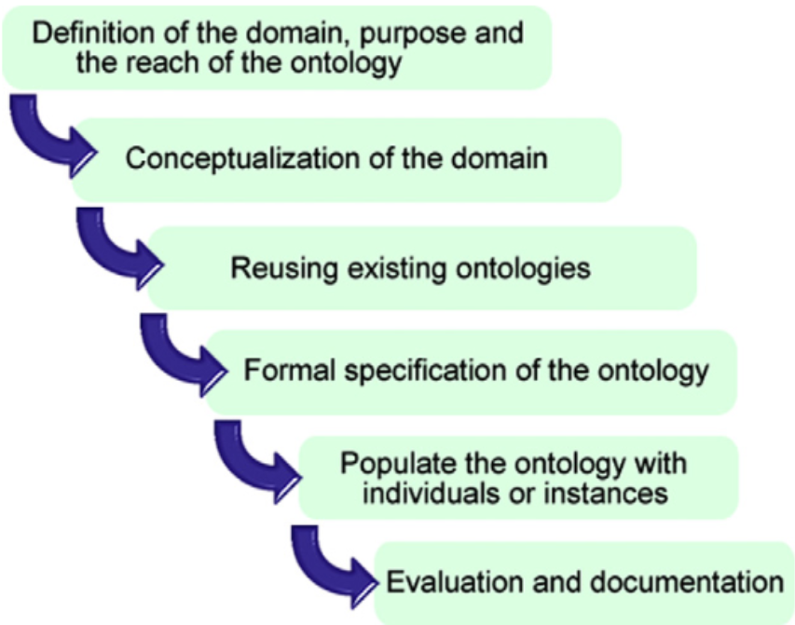
III. Ontology Design Methodologies
1. Knowledge Engineering Methodology
Six-stage process:
Definition of the domain, purpose and scope of ontology
Acquisition and conceptualization of the domain knowledge
Reusing of existing ontologies
Formal specification of the ontology
Population of the ontology with individual instances
Evaluation and documentation
Notes:
First design method is Knowledge engineering methodology, which is created in 1996, This proposal describes some of the most important tasks, involved in the process of the creation of ontologies.

Slide 20
III. Ontology Design Methodologies
1. Knowledge Engineering Methodology
Six-stage process:
Definition of the domain, purpose and scope of ontology
Acquisition and conceptualization of the domain knowledge
Reusing of existing ontologies
Formal specification of the ontology
Population of the ontology with individual instances
Evaluation and documentation
Notes:
It starts with the definition and conceptualization of the domain, we need to define the domain, purpose and scope of ontology, we need to define the domain the ontology covers, which ontology queries provide information, and who uses and maintains the ontology. For example, Domain: Restaurant Industry Purpose: Facilitate information retrieval and reasoning about restaurants. Scope: Includes information on restaurant types, cuisines, locations, menus, prices, reviews, and amenities

Slide 21
III. Ontology Design Methodologies
1. Knowledge Engineering Methodology
Six-stage process:
Definition of the domain, purpose and scope of ontology
Acquisition and conceptualization of the domain knowledge
Reusing of existing ontologies
Formal specification of the ontology
Population of the ontology with individual instances
Evaluation and documentation
Notes:
After define and conceptualize the domain and scope, we need an analysis phase in order to

Slide 22
III. Ontology Design Methodologies
1. Knowledge Engineering Methodology
Six-stage process:
Definition of the domain, purpose and scope of ontology
Acquisition and conceptualization of the domain knowledge
Reusing of existing ontologies
Formal specification of the ontology
Population of the ontology with individual instances
Evaluation and documentation
Notes:
reuse existing ontologies in the model that is being built. The goal is to achieve quality and consistency between ontologies, more over this will make us more Focus on Domain Specificity, and Reduced Redundancy. Two main processes associated with the reuse of existing ontologies are ontology merging and ontology alignment. The difference between these two processes is that the merging of different ontologies results in a single coherent ontology, while the aligning of different ontologies establishes links between the concepts of the aligned ontologies, allowing them to reuse information from one another.

Slide 23
III. Ontology Design Methodologies
1. Knowledge Engineering Methodology
Six-stage process:
Definition of the domain, purpose and scope of ontology
Acquisition and conceptualization of the domain knowledge
Reusing of existing ontologies
Formal specification of the ontology
Population of the ontology with individual instances
Evaluation and documentation
Notes:
Next, the formal specification of the ontology includes the definition of the taxonomy of concepts, the attributes and relations.

Slide 24
III. Ontology Design Methodologies
1. Knowledge Engineering Methodology
Six-stage process:
Definition of the domain, purpose and scope of ontology
Acquisition and conceptualization of the domain knowledge
Reusing of existing ontologies
Formal specification of the ontology
Population of the ontology with individual instances
Evaluation and documentation
Notes:
Once the ontology has been built, the next phase in volves the creation of the individuals or instances that populate the ontology,

Slide 25
III. Ontology Design Methodologies
1. Knowledge Engineering Methodology
Six-stage process:
Definition of the domain, purpose and scope of ontology
Acquisition and conceptualization of the domain knowledge
Reusing of existing ontologies
Formal specification of the ontology
Population of the ontology with individual instances
Evaluation and documentation
Notes:
And finally is the evaluation and documentation processes.

Slide 26
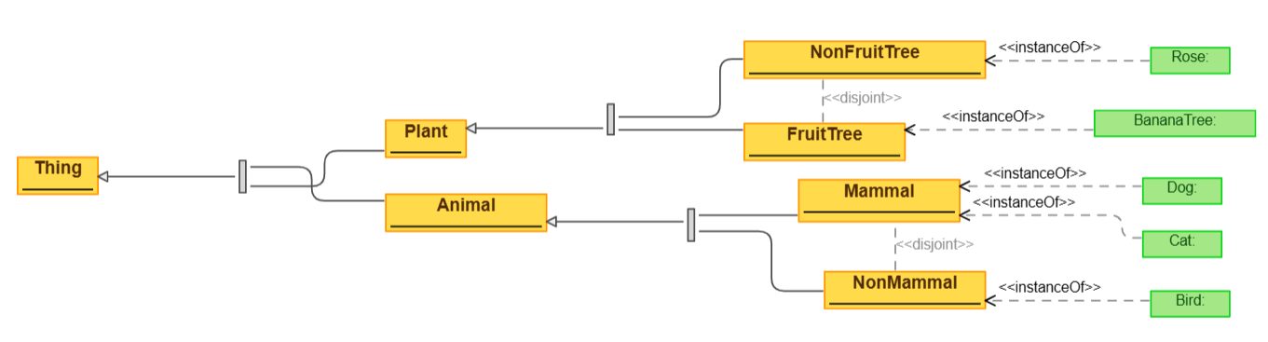
Example
1. Define domain, scope: Living thing
2. Acquisition and conceptualization of the domain knowledge: concept: Animal, Tree, Mammal, Nonmammal, Fruittree, Nonfruittree
3. Reusing of existing ontologies: None
4. Formal: specification: Protege, Plant disjoint Animal, Mammal disjoint Nonmammal, Fruittree disjoint Nonfruittree, …
5. Populate the ontology with individual: create invidual: Bird, Cat, Dog, bananaTree, Rose...
6. Evaluation and Documentation: Satisfy 5 criterias

Slide 27
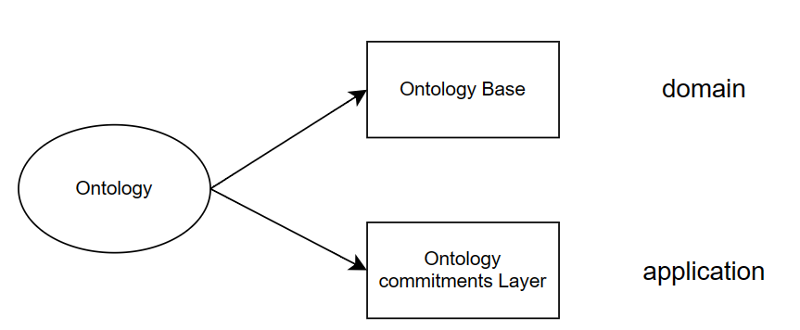
III. Ontology Design Methodologies
2. DOGMA Methodology
Goal:
Focus on Reusability and design Scalability
Separation of Concerns
→ Approach: Double articulation principle
Domain axiomatization
Application axiomatization.
Notes:
Next method i will introduce here is DOGMA. The goal of the dogma method is to build an ontology that is easy to reuse and extend, so the dogma approach is: Separate the ontology specifications from their axioms.
We spilit dogma into 2 part: Domain axiomatization as you can see here is ontology base and Application axiomatization and as you can see here is ontology commitments layer.
Domain axiomatization captures the general knowledge about a domain, focusing on intended meanings and relationships between concepts.
Application axiomatization tailors the ontology for a specific application's needs, selecting relevant parts from the domain axiomatization and potentially adding constraints.
By separating domain and application knowledge, DOGMA promotes reusability of the core domain ontology across different applications.
The modular approach allows for easier maintenance and extension of the ontology as new knowledge or applications emerge.
Moreover, Separating concerns helps to make the ontology more understandable and manageable.

Slide 28
III. Ontology Design Methodologies
Example
Domain: E-comercial
Domain Axiomatization:
Concepts:
Product, Category, Attribute (e.g., color, size, brand), Value (specific value of an attribute, e.g., "red", "medium"), ….
Relationships:
BelongsTo: a Product belongs to one Category
HasAttribute: a Product can have Attribute
HasValues: an Attribute can have Values
Application Axiomatization:
Recommendation Engine: Axioms can specify how to recommend similar products based on a customer's browsing history or previous purchases.
→ HasRating: How many points is the product rated
Search Engine: Axioms can define how to match customer searches with products based on category, attributes, and values
→ Weighting Attribute Importance: Define weights for different attributes based on their importance for specific product categories. This allows prioritizing products that search display.
Notes:
I will provide a case study applying the DOGMA methodology.
This is a simplified example, but it demonstrates how DOGMA facilitates the development of a flexible and extensible e-commerce system.
First, we need to define the domain of this ontology: e-commerce.
For e-commerce, we will have concepts such as product, category, attribute (like color, size, brand), and value (the specific value of an attribute).
Regarding relationships: We have "belongs to," which means a product belongs to one category. "Has attribute" means a product can have an attribute, and "has value" means an attribute can have values.
Having designed the domain axiomatization, we will now consider some application axiomatization.
For example, with a recommendation engine, axioms can specify how to recommend similar products based on a customer's browsing history or previous purchases. Here, we would introduce a relationship called "HasRating" to represent how many points a product is rated.
Another example is with a search engine. Axioms can define how to match customer searches with products based on category, attributes, and values. We can introduce an attribute named "Weighting Attribute Importance" to define weights for different attributes based on their importance for specific product categories. This allows prioritizing products that match the search query.

Slide 29
III. Ontology Design Methodologies
3. DILIGENT Methodology
DILIGENT (DIstributed, Loosely-controlled and evolvInG Engineering of oNTologies) is a methodology specifically designed for building and maintaining ontologies in distributed settings, such as the Semantic Web or large peer-to-peer networks.
Notes:
For the define of Diligent, DILIGENT is a methodology specifically designed for building and maintaining ontologies in distributed settings, such as the Semantic Web or large peer-to-peer networks.
They key characteristics of DILIGENT:
Distributed Development: Unlike traditional methods where domain experts gather in one place, DILIGENT acknowledges the possibility of geographically dispersed experts collaborating on the ontology.
Loose Control: It avoids overly rigid control mechanisms, allowing for flexibility and adaptation as knowledge evolves.
Evolutionary Approach: DILIGENT recognizes that knowledge is not static and the ontology should be able to accommodate changes and additions over time.

Slide 30
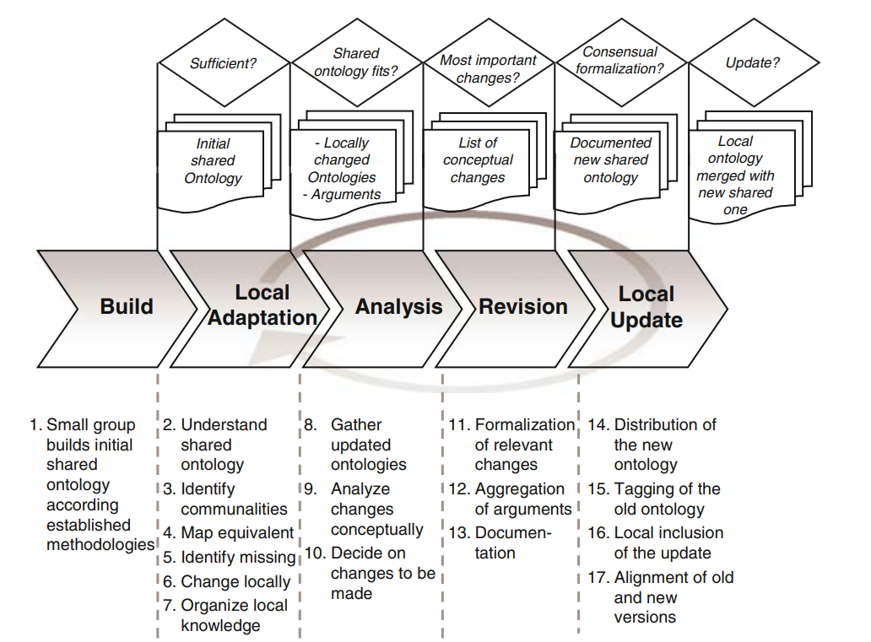
III. Ontology Design Methodologies
General process
General process, roles and functions in the DILIGENT process include five main activities:
Build
Local adaptation
Analysis
Revision
Local update
Notes:
The Ontology Design Process for Distributed Systems Includes 5 Main Activities:
Construction: We begin by creating an initial ontology.
This ontology is then shared and made available for users.
Local Adaptation Integration: Users can modify the ontology within their local environment.
Importantly, the original ontology remains unchanged (similar to cloning a repository in Git for making specific modifications).
Analysis: The control board collects and analyzes change requests to the shared ontology. The board must decide which changes need to be introduced in the next version of the shared ontology (similar to reviewing a pull request in Git).
Revision: . A balanced decision must be made that takes into account the different users’ needs and meets their evolving requirements. The control board revises the shared ontology accordingly. Once a new version of the shared ontology has been released.
Local Update: Users can download the updated (revised) version of the ontology.
This process then repeats, creating a continuous loop for improvement.

Slide 31
Conclusion
There is no one “correct” way or methodology for developing ontologies. The best solution almost always depends on the application that you have in mind and the extensions that you anticipate.
Design and develop an ontology-based information systems need cooperative work between:
Domain experts
Ontology designers
Knowledge engineers
Software engineers
…
Ontology development is necessarily an iterative process.

